Slide 1
Business Problem
Nike lacks clear insights into product performance, customer preferences, and seasonal demand leading to missed sales opportunities and suboptimal inventory and marketing decisions

Slide 2
Project Flow
Data Collection : Kaggle sales dataset
Data Understanding : Analyzed 50K+ records
Data Exploration : Checked nulls, outliers, distributions
Data Cleaning : Removed 2% incorrect data
Visualization & Insights : Charts for sales trends, top products, regions, peak months
Data Overview :
Data Size : 50,250 rows X 13 columns
Period Covered : Jan 2023 – Mar 2024
Target variable:
Revenue: Represents overall sales performance and directly reflects Nike’s business growth

Slide 3
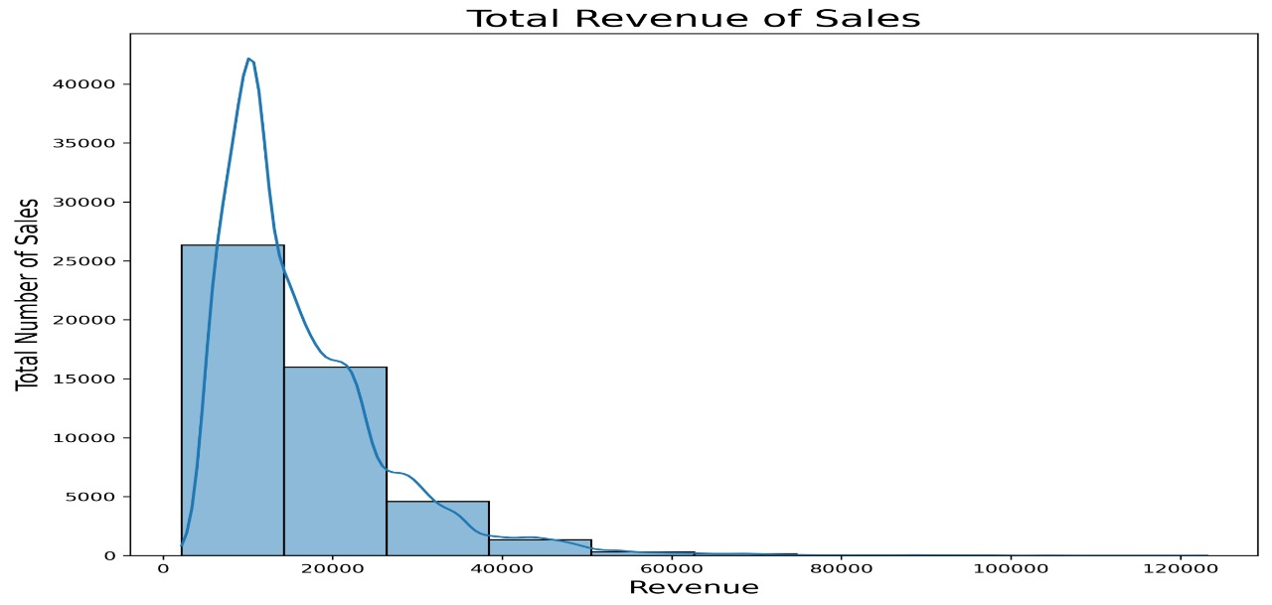
Most Nike sales revenue falls between 10,000-20000 showing a high concentration of mid-range sales. However, a few transaction reach beyond 1,00,000 indicating rare but reflecting lower demand for premium-priced products.

Slide 4
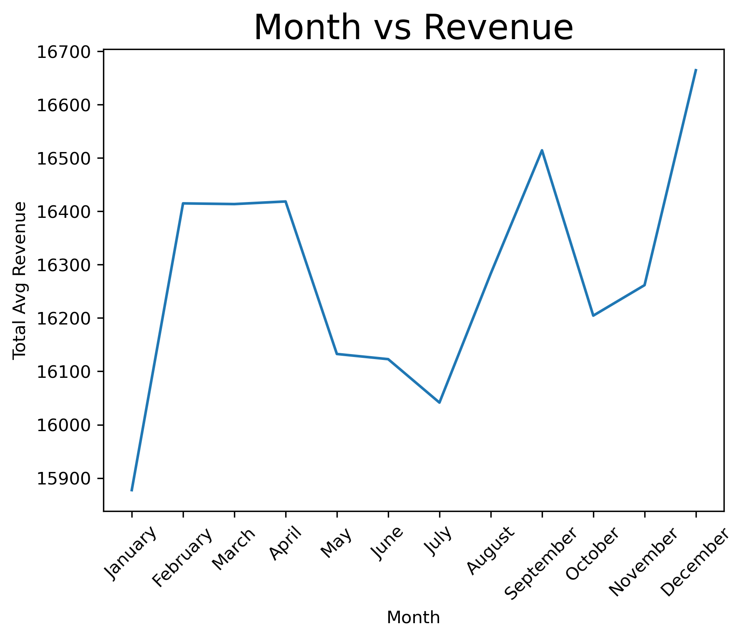
Steady Growth(Jan-Apr)Sales start strong in the first quarter and keep rising till Apr showing early-year performance.
Mid-Year Drop: Revenue declines from May to July, indicating a seasonal slowdown in sales.
Year-End Peak: From August onward, sales grow sharply, reaching their highest levels in November and December due to festive demand.

Slide 5
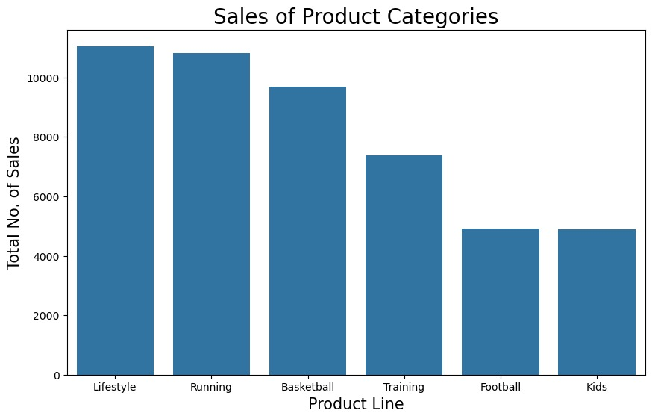
The Running and Lifestyle categories have the highest sales, indicating strong costumer demand in these segments.
Basketball and Training products also perform well, while kids and football lines have comparatively lower sales suggesting potential areas for improvement or targeted marketing,.

Slide 6
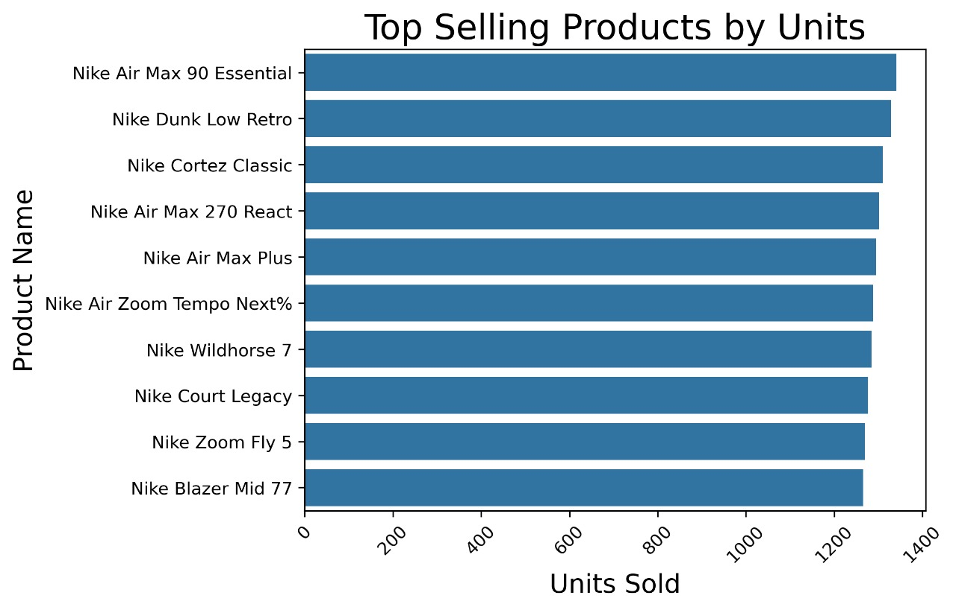
Nike Air Max 90 essential leads as the highest selling product, Followed closely by Nike dunk low retro and Nike Cortez Classic, Overall, The Air Max series dominated the top positions ,showing strong costumer preference for comfort and style-Oriented footwear.

Slide 7
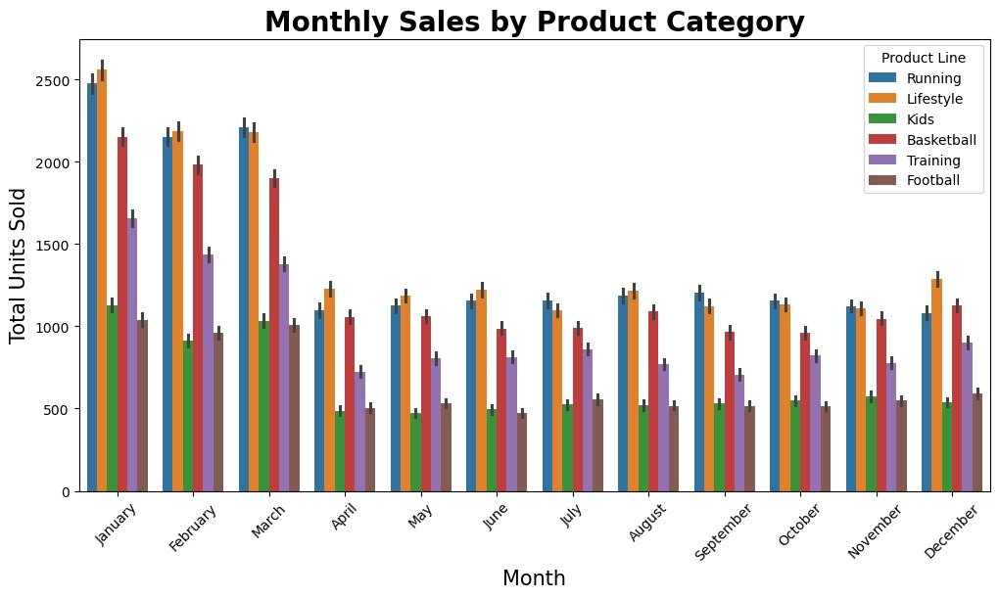
Sales are highest in January and march.
Running and lifestyle Categories lead consistently cross months.
Kids and football product lines have lower sales performance.

Slide 8
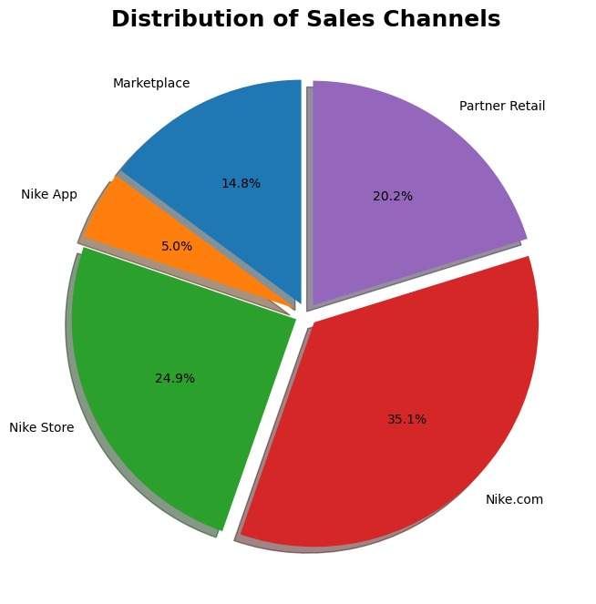
    Nike.com contributes the highest sales share (35.1%), showing strong online performance.
Nike Stores follow with 24.9%, indicating solid offline presence
Nike App has the lowest share (5%), suggesting scope to improve app-based engagement and marketing.

Slide 9
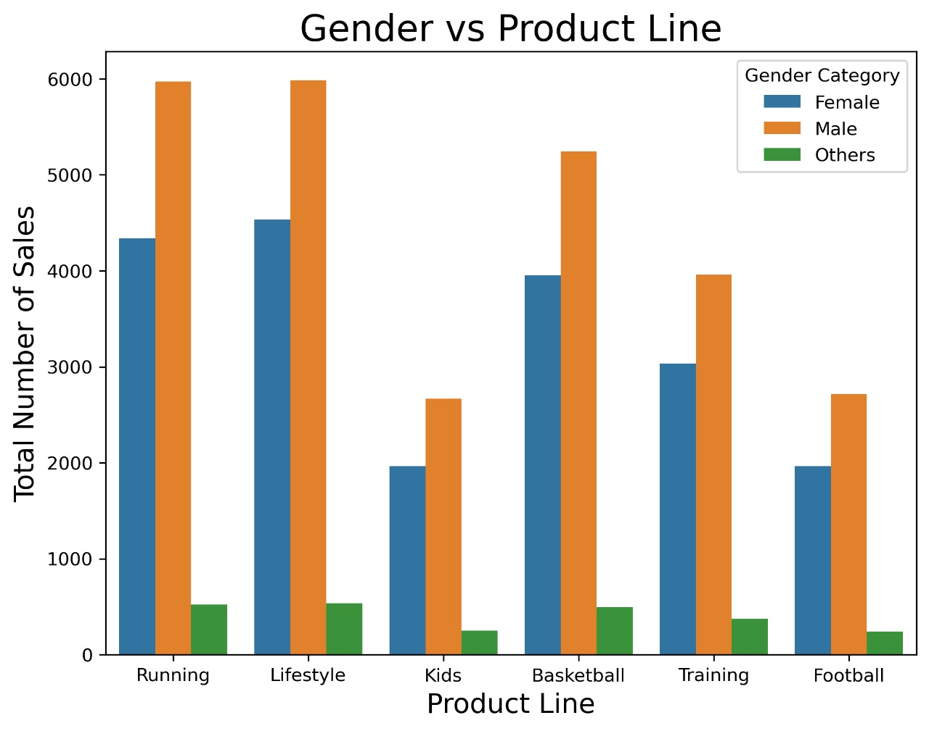
The graph shows that males have higher sales across all product lines specially running, lifestyle and basketball categories female sales are significant but consistently lower than male sales.

Slide 10
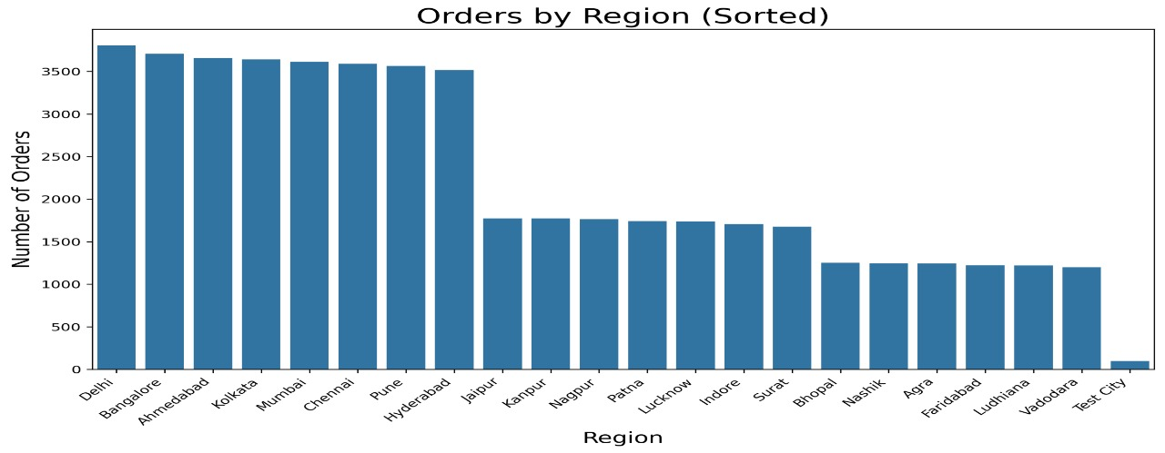
Major metropolitan cities like Delhi Bangalore Ahmedabad and Mumbai records the highest number of Nike orders indicating strong market demand and brand presence in contrast smaller regions such as Nashik, Ludhiana show lower order values, suggesting lower brand reach.

Slide 11
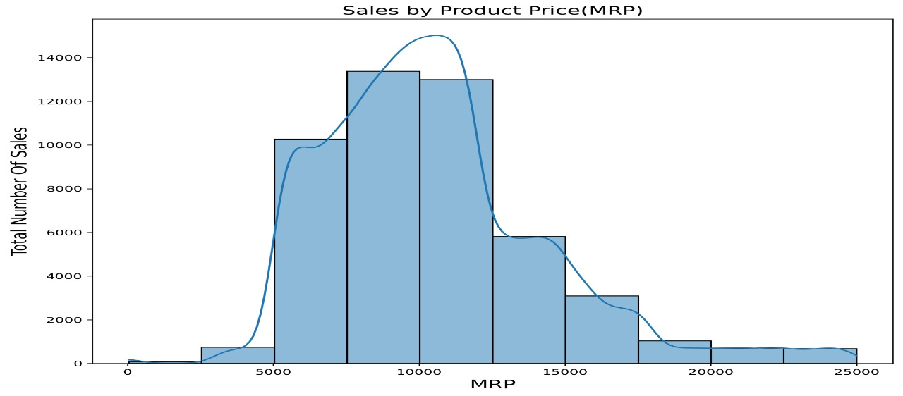
Most Nike products priced between RS.8000 and RS.12000 show the highest sales volume indicating strong customer preference for this price range. Sales decline significantly beyond RS.15000 suggesting reduced demand for higher priced products.

Slide 12
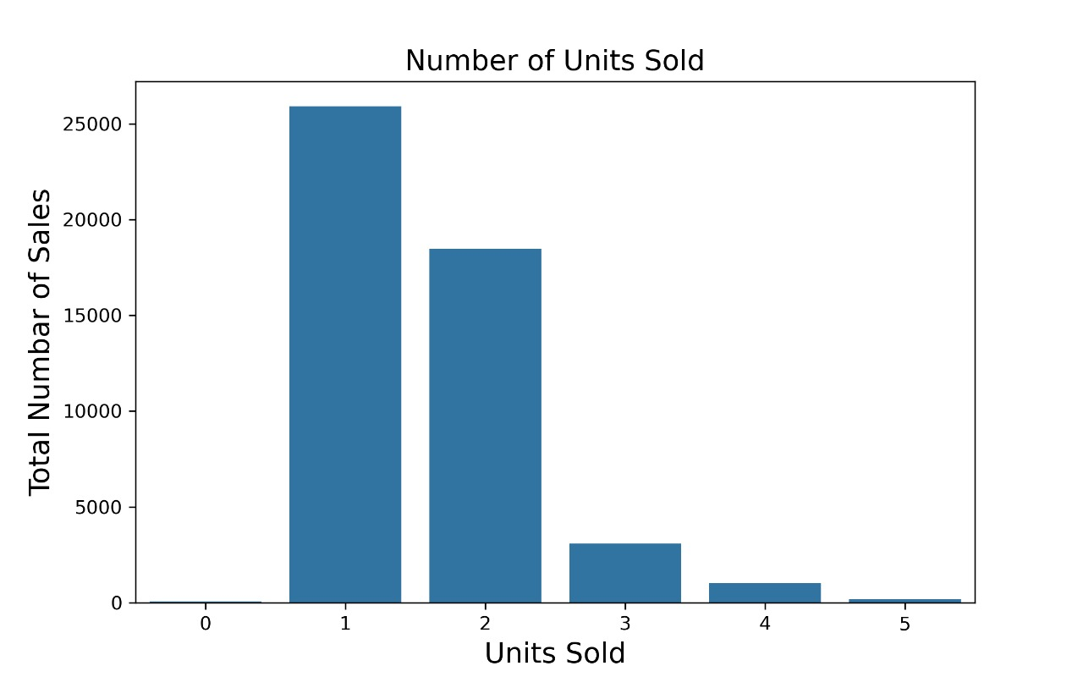
The “Units Sold” column shows that most orders consisted of one unit with very few orders having higher quantities

Slide 13
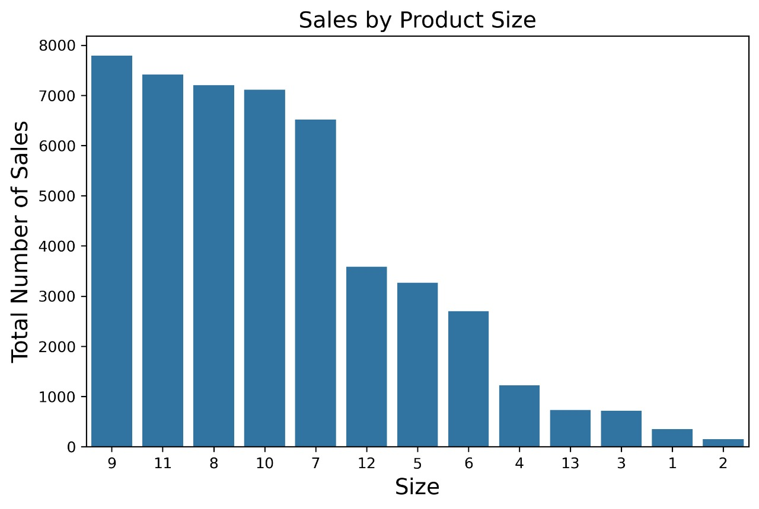
The analysis shows that product sizes 9,11 and 8 recorded highest sales indicating strong costumer preference for mid range sizes in contract smaller and larger sizes.

Slide 14
Insights & Recommendations:
Product Strategy:
Focus on Running and Lifestyle categories top revenue drivers.
Promote Kids and Football through targeted discounts and influencer marketing.
Strengthen mid-range(8K-12K) portfolio to match customer demand.
Seasonal Sales Planning:
Revenue drops during May-July plan clearance or summer offers.
Peak in November-December- Increase stock and festival campaigns.
Use data analytics to improve seasonal demand forecasting.
Channel Performance:
Nike.com leads with~35% sales – optimize online promotions.
Nike App(5%) needs engagement via app-only offers.
Maintain balanced stock between online and retail stores.
Regional & Pricing Focus:
Prioritize metro markets(Delhi, Bangalore, Mumbai) for higher ROI.
Expand reach in smaller cities through local promotions.
Maintain inventory in 8K- 12K range and sizes 8-11.

